Slide 1
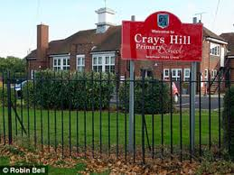
Welcome to
Crays Hill Primary School
Intake 2020/ 2021

Slide 2
Who are we?
Class 1
Mrs Winch
Mrs Willis

Slide 3
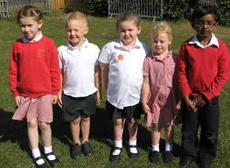
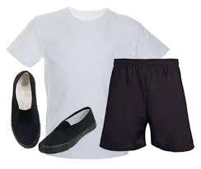
What do we wear to school?
This is our school uniform
This is what you will need for PE

Slide 4

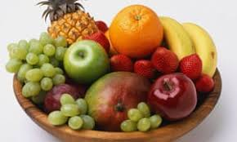
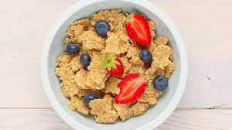
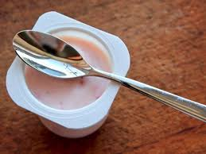
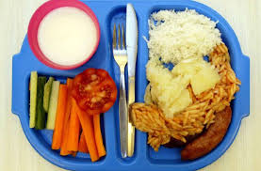
Snack and Lunch
We have fruit for snack at playtime.
We have delicious school dinners.
You can have breakfast at school as well.

Slide 5
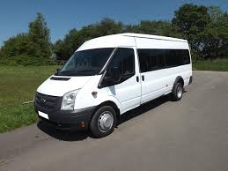
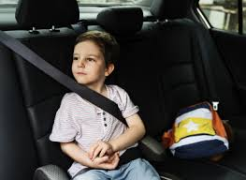
How do I get to school and home?
The school bus will pick you up and bring you to school.
At the end of the day the bus will take you home.
You must always wear your seatbelt on the school bus.

Slide 6



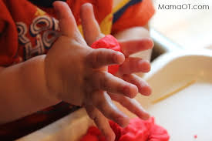
What will school look like?
Prime areas
Physical development skills
Communication and language skills

Slide 7
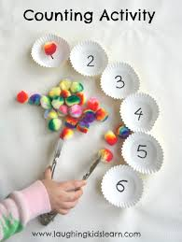


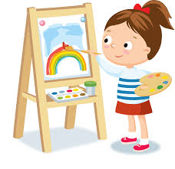

What will school look like?
Specific Areas of Learning
We count and sort during Maths.
We will learn our sounds to help us read and write.
We can be creative and explore colour and texture.
We think about where we live and the world around us.

Slide 8


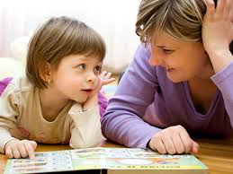

Listening and singing
At home can you sing songs with your child, listen to sounds around them and talk about stories?

Slide 9
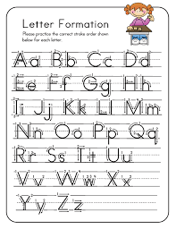
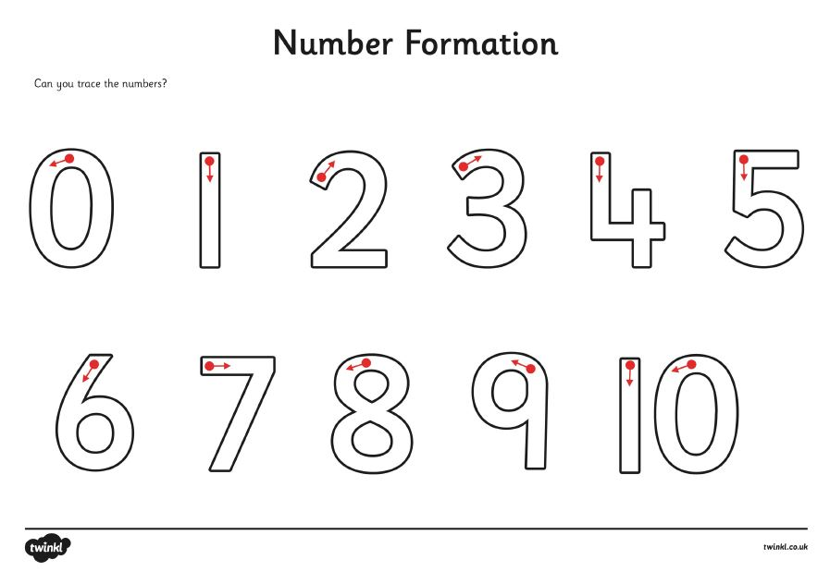

How do we hold our pencil?
This is how we hold our pencil to form our letters and numbers.

Slide 10

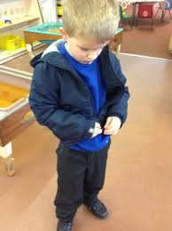
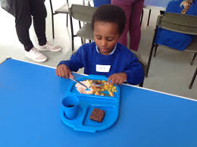
Help from home
Transitions
Things we need to know
How you can help your child
How we will help your child

Slide 11
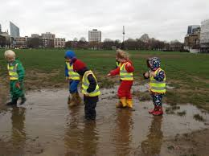
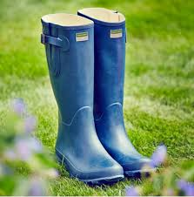
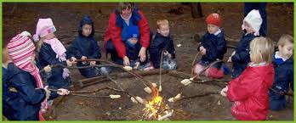
Forest School
We take part in Forest School sessions.
Our sessions will be in February
and March
You can bring your own outdoor clothes.

